Slide 1
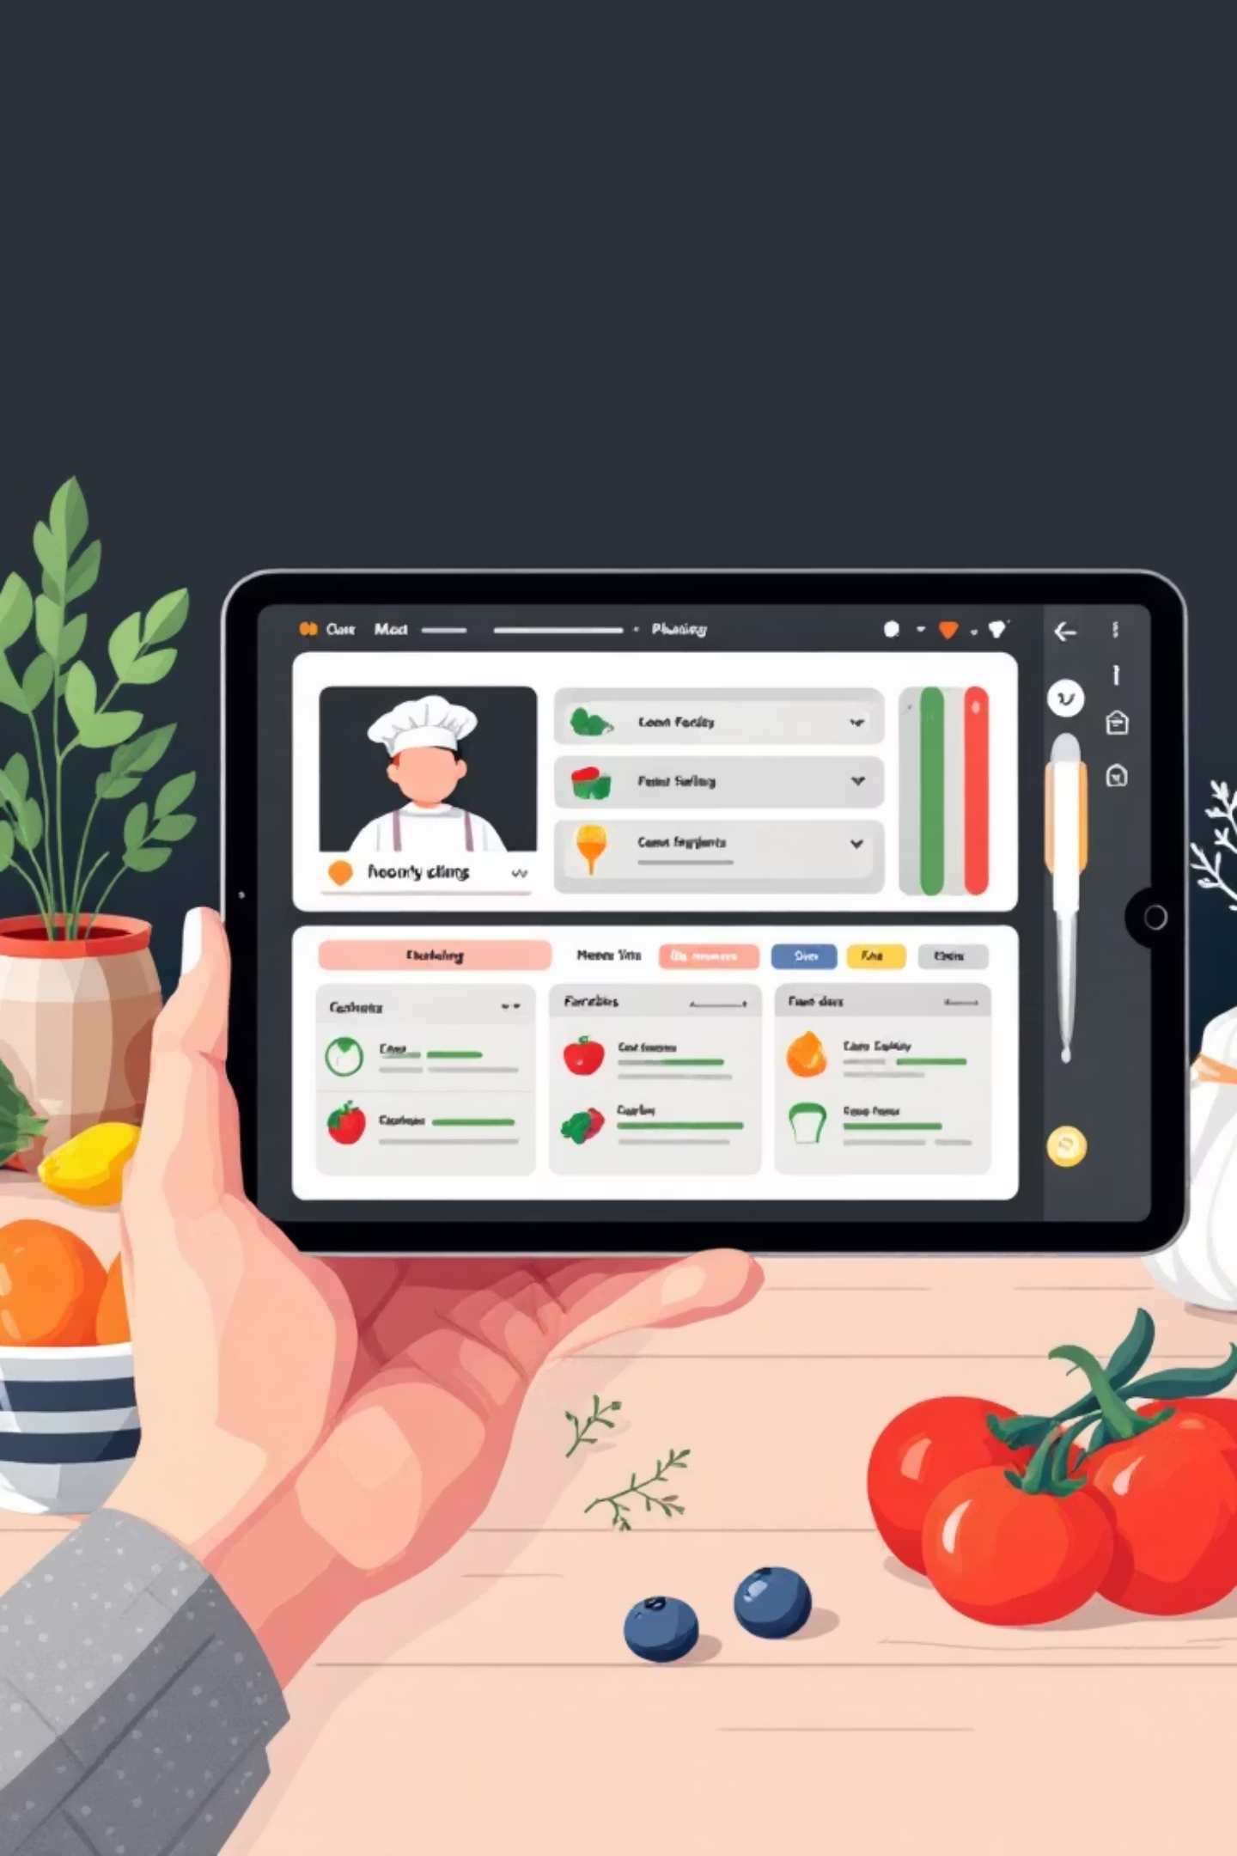
Student Meal Planner
A Grade 12 NEB Computer Science Project
Presented by: Samriddhi Baiju,
Sara Karmacharya,
Anuska Basnet,
Shrena Prajapati
Khwopa Secondary School, Bhaktapur
-Computer Science Department

Slide 2

INTRODUCTION
Why a Meal Planner?
High school students often juggle many responsibilities, and among them, managing daily meals can be a real challenge. They frequently struggle with balancing a tight budget with the need for healthy, appealing food choices. This leads to skipped meals, unhealthy eating habits, or overspending.
Our project aimed to tackle this problem head-on. By leveraging the power of web applications, we sought to simplify daily planning and decision-making, offering a practical solution to a common student dilemma.
Our goal was to create a simple, web-based tool that empowers students to plan meals based on their budget and food preferences.

Slide 3

OBJECTIVES
What We Aimed to Achieve
Beyond solving a practical problem, this project was a significant learning opportunity. Our objectives focused on both technical skill development and creating a useful application.
Practical Web Skills
User-Centric Design
Demonstrate the use of core web technologies: HTML, CSS, and JavaScript.
Design an interactive and user-friendly web application that's intuitive to navigate.
Dynamic Functionality
Affordable Meal Choices
Process user input and generate dynamic, appropriate output using JavaScript logic.
Provide a practical solution for students to make affordable meal choices efficiently.

Slide 4



TECHNOLOGY
Our Tech Stack
We built the Student Meal Planner using fundamental web development languages, each playing a crucial role in the application's structure, appearance, and functionality.
HTML (HyperText Markup Language)
CSS (Cascading Style Sheets)
JavaScript
The core intelligence of our planner. JavaScript handled all the dynamic functionality:
The backbone of our webpage, HTML was used to structure all content, including input fields for preferences, buttons for actions, and the display area for meal results.
CSS brought our application to life! It was instrumental in styling the interface, ensuring it was not only visually appealing but also easy for students to use and navigate.
Processing user inputs (budget, meal type, preference)
Filtering and randomly selecting meals from our dataset
Dynamically updating the webpage with the chosen meal and its details

Slide 5
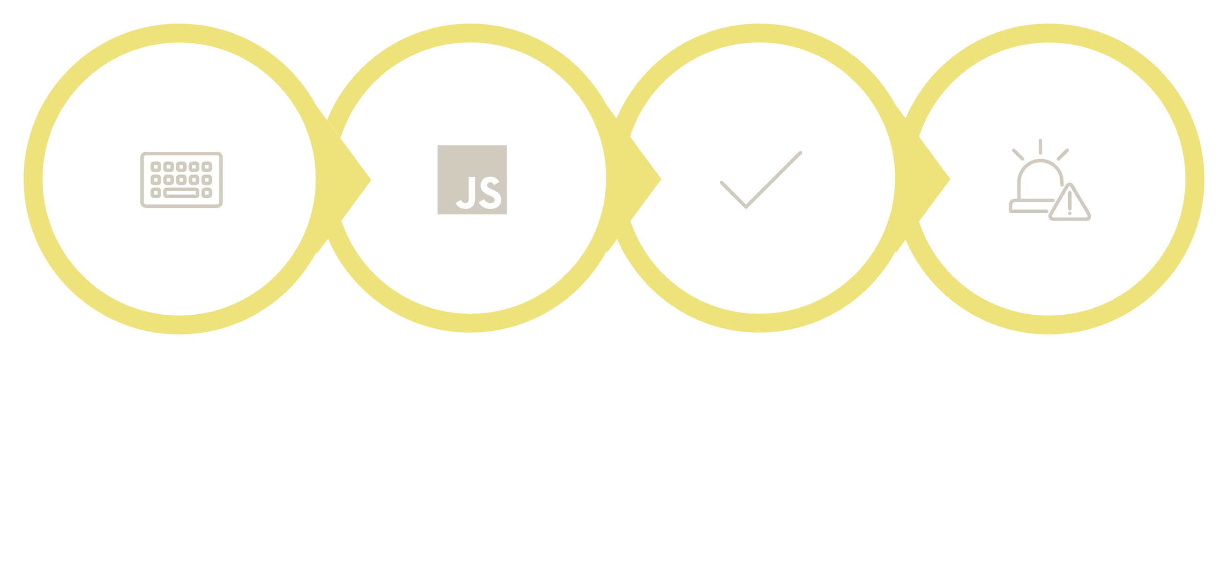




HOW IT WORKS
Application Logic & Functionality
The Student Meal Planner follows a clear, step-by-step process to generate meal suggestions. This diagram illustrates the flow from user input to final output.
Error Handling
User Input
Processing
Output
When a user requests a meal plan, the application efficiently filters through available options to find the perfect fit or notifies them if no suitable meal is found.

Slide 6
CONCEPTS
Learning in Practice
This project allowed us to apply several fundamental programming concepts in a practical, problem-solving context, solidifying our understanding of how code translates into a functional application.
Functions & Logic
Data Structures
Function Definitions & Calls: Modularized our code, separating concerns like input processing (planMeal()) and meal selection (getRandomMeal()).
Conditional Statements (if/else): Essential for filtering meals based on user criteria (budget, preference) and for error handling.
DOM Manipulation (getElementById, innerHTML): Crucial for dynamically updating the webpage and displaying results without reloading.
Event Handling (onclick): Made the application interactive, responding to user actions like clicking the "Plan Meal" button.
Arrays: Used to store collections of meal objects, making it easy to iterate and filter.
Objects: Each meal's data (name, cost, type, ingredients, calories) was structured as an object for clear organization and access.

Slide 7


Project Scope & Future Enhancements
Our Student Meal Planner provides a robust foundation, but like any good project, it has clear areas for future growth and expansion.
Current Scope: What it is
Limitations & Future Enhancements
Front-end Only: The application operates entirely within the user's browser.
Core Concepts: Successfully demonstrates fundamental web development principles.
Static Data: Relies on a predefined, fixed list of meal data embedded within the code.
Backend & Database Integration: Connect to a server and database for dynamic, continuously expandable meal recipes and ingredients.
User Accounts: Implement user authentication to allow saving personalized preferences, meal plans, and favorite recipes.
Advanced Features: Introduce nutrition tracking, automated shopping list generation, or even meal sharing functionalities.

Slide 8

CONCLUSION
Key Takeaways & Learning Outcomes
Through dedicated effort, we successfully developed a functional Student Meal Planner web application. This project was more than just coding; it was a journey of integrating HTML, CSS, and JavaScript to address a real-life problem faced by many students.
1
Enhanced Problem-Solving
Reinforced our ability to break down a problem, design a solution, and implement it systematically.
2
Practical Skill Application
Provided invaluable hands-on experience in logic building, effective data handling, and creating an intuitive, interactive user interface.
3
Foundation for Growth
This project serves as a strong foundation, equipping us with essential skills and confidence for future, more complex front-end web development endeavors.

Slide 9
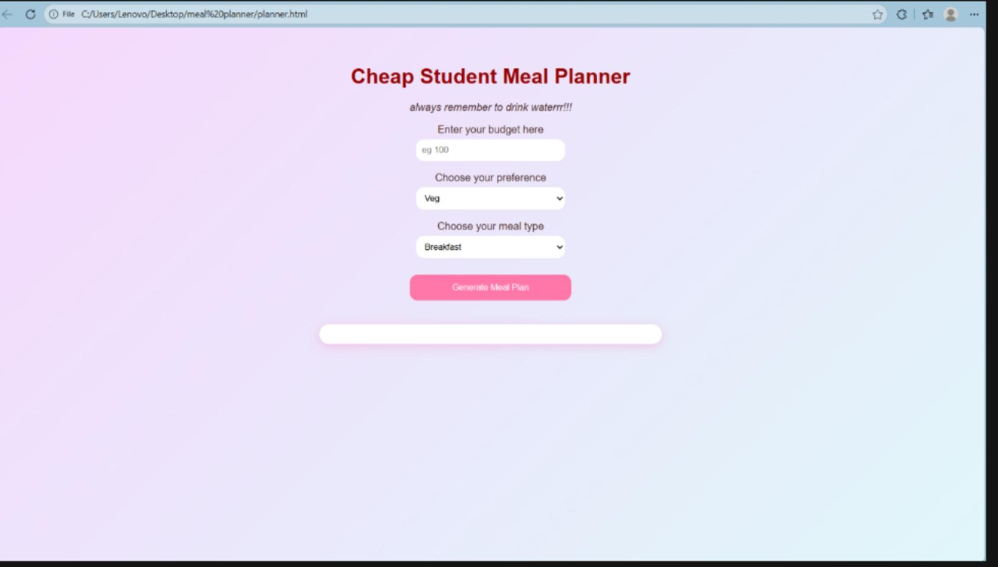
Live Demonstration
Now, let's see the Student Meal Planner in action!
We'll explore the intuitive input interface.
Generate various meal plans with different budget and preference criteria.
See how the application gracefully handles scenarios where no meals match the criteria.
"This demonstration will showcase the simplicity and effectiveness of our solution."

Slide 10

Conclusion
In conclusion, the Student Meal Planner project successfully demonstrates how foundational web technologies—HTML, CSS, and JavaScript—can be applied to develop a practical, user-centered application that addresses a real-world need. Through this project, we not only created a functional tool to assist students in making affordable and personalized meal choices but also strengthened our understanding of front-end development, logical programming, and interactive design. This experience has solidified our ability to translate theoretical concepts into working solutions and has provided a valuable foundation for future explorations in software development and problem-solving using technology.

Slide 11
Thank You!
We are now open for any questions.
Samriddhi Baiju
Sara Karmacharya
Anuska Basnet
Shrena Prajapati

